Slide 1

HTTP METHODS IN MULESOFT
By: RUKHSANA TASNEEM
n Date:16/12/2021

Slide 2
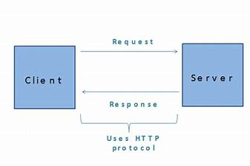
Http request methods
What is http request method?
HTTP is a protocol that is used in requests and responses for effective communication between client and server. A message sent by the client to the server is known as an HTTP request. When these requests are being sent, clients can use various methods, known as HTTP request methods.
Types of http request methods:
Various HTTP methods are:
GET, POST, PUT, HEAD, DELETE, TRACE, OPTIONS, and CONNECT etc.

Slide 3
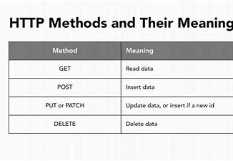
TYPES:
GET: The GET method is one of the most commonly used methods of HTTP. It is usually implemented to request a particular resource data from the Web server by specifying the parameters as a query string (name and value pairs) in the URL part of the request.
POST: The POST method is a commonly used HTTP method that sends data to the Web server in the request body of HTTP.
PUT: The HTTP PUT request method is used to update existing resources with uploaded content or to create a new resource if the target resource is not found.
DELETE: The HTTP DELETE method is used to delete any specific resource.

Slide 4
THANK YOU

